Slide 1

Don’t mess with the Rombertik

Slide 2
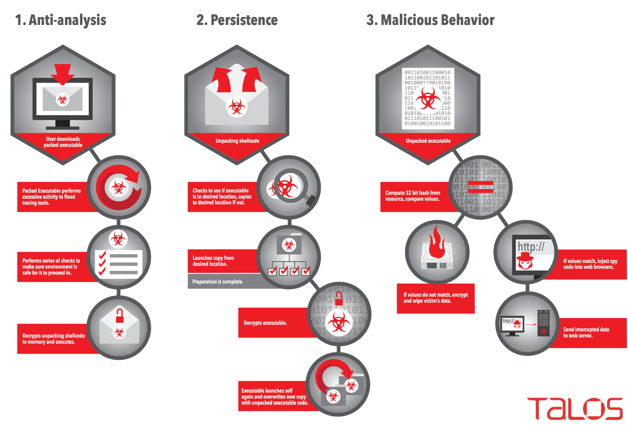
Compromise flow of Rombertik

Slide 3

What it is?
50% Blastware
50% Spyware
First comes Blastware then comes Spyware

Slide 4
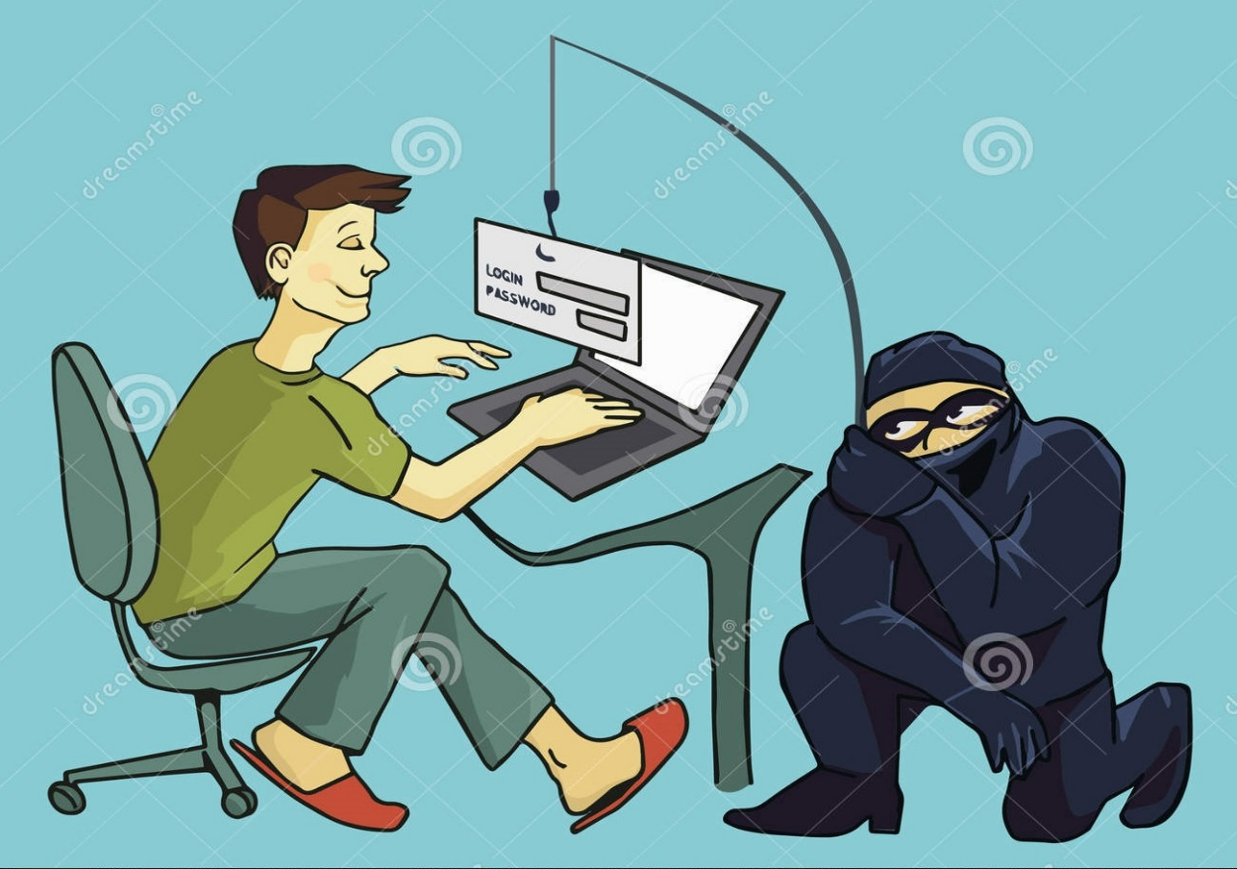
How it works?
Phishing
Attracts targets through email propositions
Program disguised as document but really is a .SCR
Compromises data after launching it

Slide 5
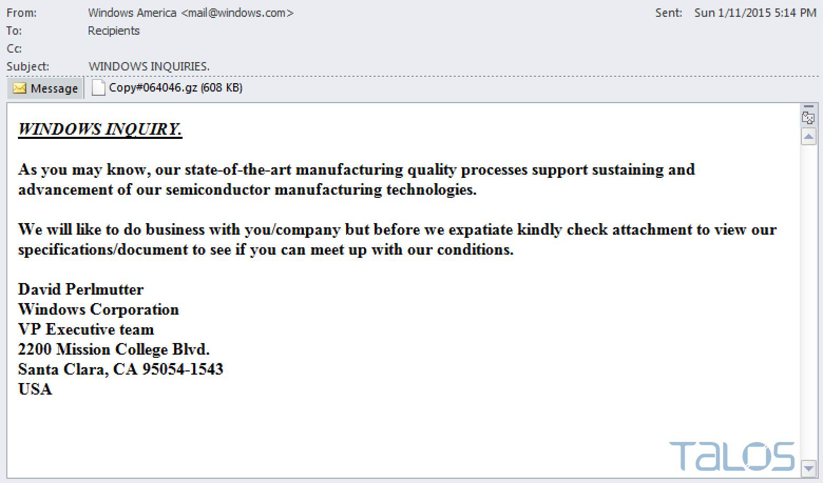
Email recovered by Talos

Slide 6
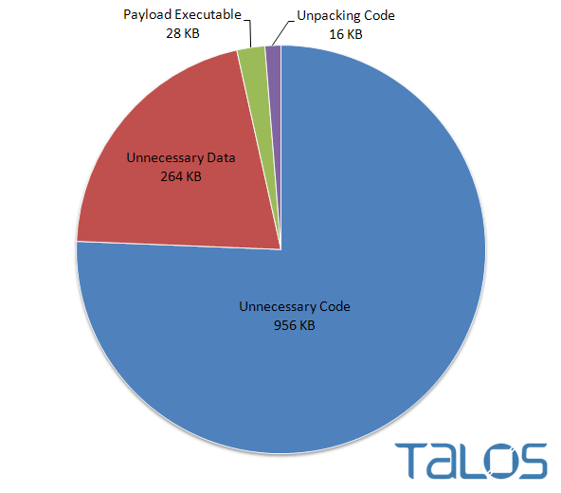
Anti-analysis
Majority of the file is garbage Code

Slide 7
Sandbox Evasion
Sleeper method 2.0
Checks Windows API method ZwGetWriteWatch routine
Calls the OutputDebugString from API
Checks current process for anti-malware extension names like “malwar”, “sampl”, “viru”, and “sandb”
Checks to see if in right location (%AppData%\rsr\yfoye.exe)

Slide 8
Extraction Process
Rombertik creates and moves itself from (%AppData%\rsr\yfoye.bat) into
(%AppData%\rsr\yfoye.exe)
Starts to unpack main code in memory
Unpacked code overwrites new process
Unpacking Process
Unpacking process much larger than Anti-analysis process

Slide 9
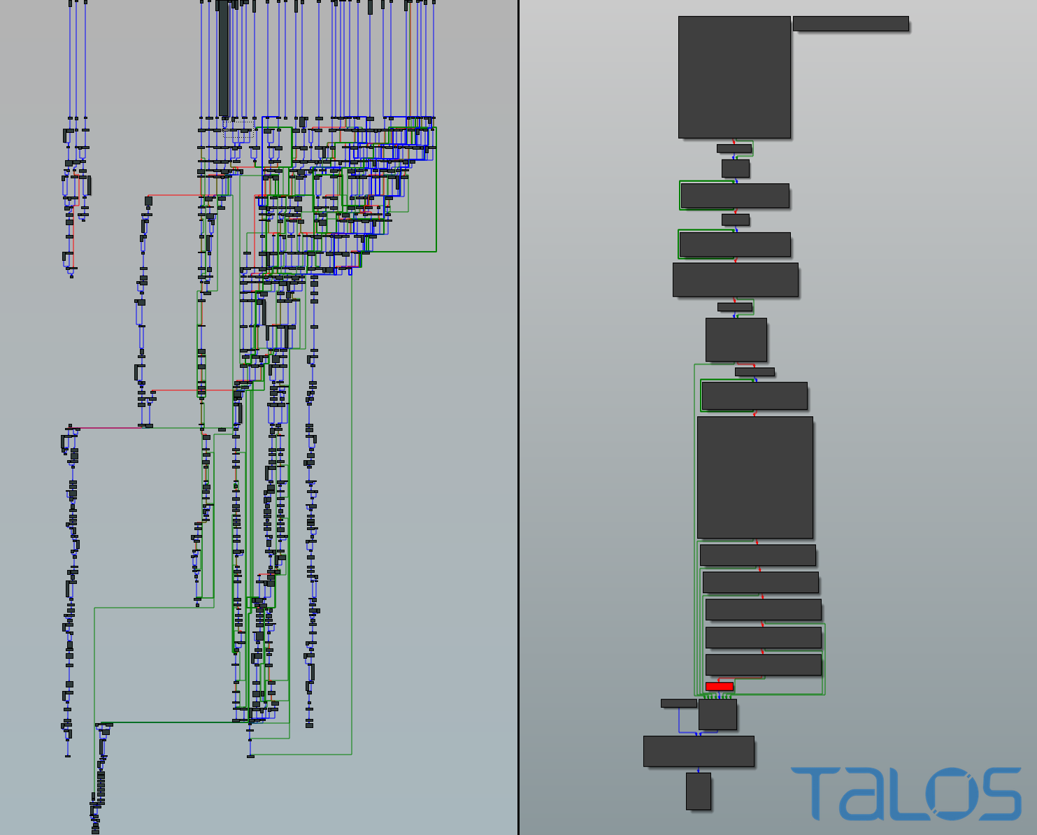
Unpacking process on left, Anti-analysis on right

Slide 10

What it does
Spyware
Captures data sent over https
Encrypts data then sends to www.centozos.org.lin/don1/gate.php

Slide 11

Blastware
Destroys OS when detected
Destroys user home files if destroying OS fails

Slide 12
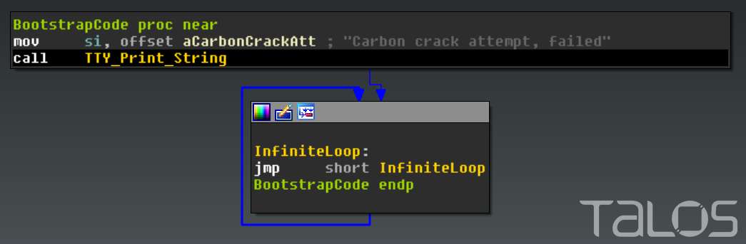
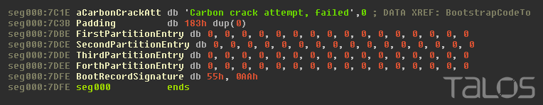
Blastware
Overwriting Boostrap execution code
Overwriting MBR disk partitions

Slide 13
Who does it affect?
Anyone with an email account and a computer

Slide 14

Cost Value
Depends on the company/Home user
Company size
Infected stations
What data was captured
Human expense
Depends on what you had on the computer and what data the malware captured

Slide 15
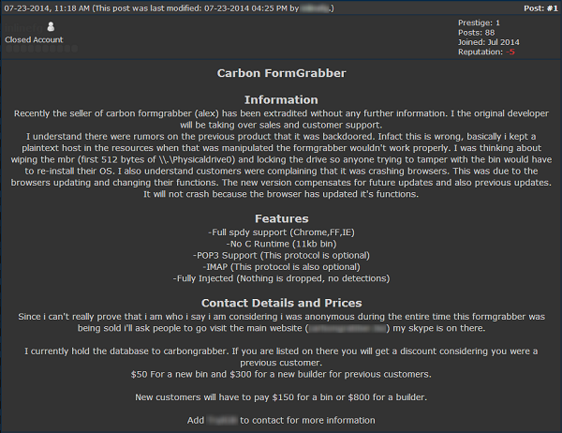
What Rombertik really is
Modified version of FormGrabber
Made by commercial criminal enterprise
Made for looser cybercriminals who don’t know how to program
Developed specific to each client Command & Control server
Destructive mechanism originally made for anti-piracy

Slide 16
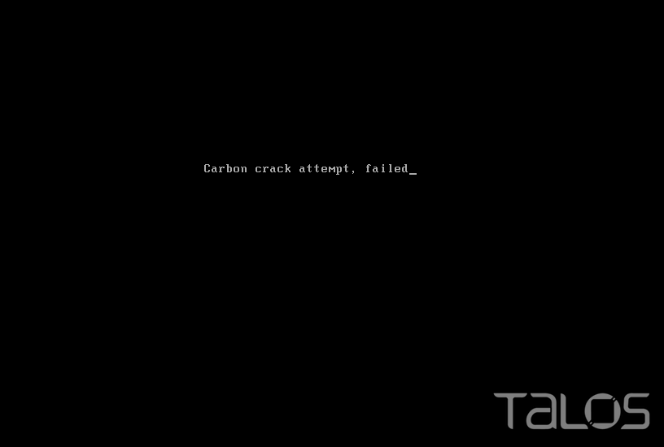
Attempting hackers receive this message when they fail to change the C&C address

